Slide 1
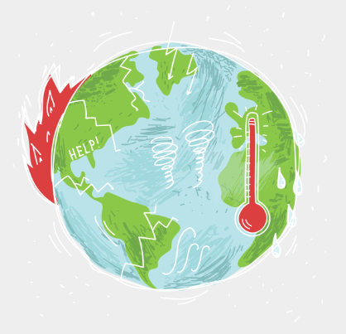
Policy Debate: Climate Reparations

Slide 2
Overview
Defining Climate Reparations
Inequality
Inequality of global emissions
Inequality of sovereign debt
Case Studies: Pakistan, Zambia, Mozambique, and Bahamas
The mechanisms of Reparations (in practice)
Barriers
Debt

Slide 3
What is climate change?

Slide 4
Climate science
Climate change: affecting the frequency, intensity and geographical distribution of extreme weather events such as storms, floods and heatwaves, and slow-onset events such as sea level rise, ocean acidification, loss of biodiversity and desertification
Atmospheric CO₂ concentration
Global Carbon budget
Paris agreement (1.5°C)
Notes:
Climate change is affecting the frequency, intensity and geographical distribution of extreme weather events such as storms, floods and heatwaves, and slow-onset events such as sea level rise, ocean acidification, loss of biodiversity and desertification.

Slide 5
What are ‘Climate Reparations’?
Notes:
Ask the question to the audience/students, they can also have 1 min to discuss this in pairs.

Slide 6
How do we respond to climate change?
1. Mitigation of climate-issues
2. Adaptation to climate-issues:
Reducing the effects of heating gases flowing into the atmosphere e.g. carbon capture; reducing the amount of carbon gases released
Adjustments to social or economic systems to moderate potential damages from climate change e.g. anticipating sea-level rises and building sea walls as a response)

Slide 7
Loss and Damages
refers to the negative consequences of climate change on human societies and the natural environment that are happening today
All of these result in loss and damage, both economic and non-economic.
Economic loss and damage include: damage to crops, homes and infrastructure, and losses from future extreme weather events (stranded assets).
Non-economic loss and damage include: harm to human health and mobility; loss of access to territory, of cultural heritage and of indigenous and local knowledge; and loss of and damage to biodiversity and habitats.
Although mitigation and adaptation measures are crucially important for future safeguarding, it does not account for the damages already being caused by climate change.
Notes:
Many countries are experiencing the effects of the climate change on a disastrous scale and mitigation and adaptation aren’t necessarily usefully implementable.
“Loss and damage refer to the negative consequences of climate change on human societies and the natural environment. Climate change is affecting the frequency, intensity and geographical distribution of extreme weather events such as storms, floods and heatwaves, and slow-onset events such as sea level rise, ocean acidification, loss of biodiversity and desertification. All of these result in loss and damage, both economic and non-economic. Economic loss and damage may include damage to crops, homes or infrastructure. Non-economic loss and damage may include harm to human health and mobility; loss of access to territory, of cultural heritage and of indigenous and local knowledge; and loss of and damage to biodiversity and habitats.”
Source:Byrnes and Surminski (2019) https://www.lse.ac.uk/granthaminstitute/explainers/what-is-climate-change-loss-and-damage/ https://www.lse.ac.uk/granthaminstitute/explainers/what-is-non-economic-loss-and-damage-neld/#:~:text=Loss%20and%20damage%20can%20be,to%20crops%2C%20homes%20or%20infrastructure.

Slide 8
Timeframe | Climate Disaster
December 2022–March 2023 | Heavy rainfall caused by atmospheric rivers led to multiple floods in the Western United States. There were at least 22 fatalities and property damages were estimated to be US$ 3.5 billion.
February 2023 | Cyclone Gabrielle caused extreme rainfall in Aotearoa New Zealand's Te Ika-a-Māui (North Island), potentially resulting in billions of dollars in damages and 225,000 homes losing power.
March–May 2023 | Record-breaking temperatures were recorded in parts of Southeast Asia, China, and South Asia. The extreme heat caused deaths and school closures in India and led to more than 100 students requiring treatment for dehydration in the Philippines. It was likely at least partly because of climate change. For example, climate change has increased the likelihood of such an event to occur over Bangladesh and India by a factor of at least 30.
September 2023 | Storm Daniel caused extreme flooding in Libya and parts of southeastern Europe, resulting in thousands of fatalities and more than 2 billion US dollars in damages. Climate change may be increasing the intensity of such storms.

Slide 9
Climate Reparations are...
…. compensation for harm caused by climate change by those who emit more to those that are under-emitting.
This can be in the form of economic transfers
From:
Countries/Global North
Firm-level
Individuals
To:
Countries/Global South
Communities
Citizens
Notes:
Climate reparations are compensation for harm caused by climate change.
For a number of years climate policy-makers and international climate negotiators have argued that countries that have a high emission per capita owe compensation to countries that have a low emission per capita for climate-related damages and who face high costs due to climate related effects. This inequality argument will be explored in the following section.

Slide 10
Inequality of Global Emissions

Slide 11
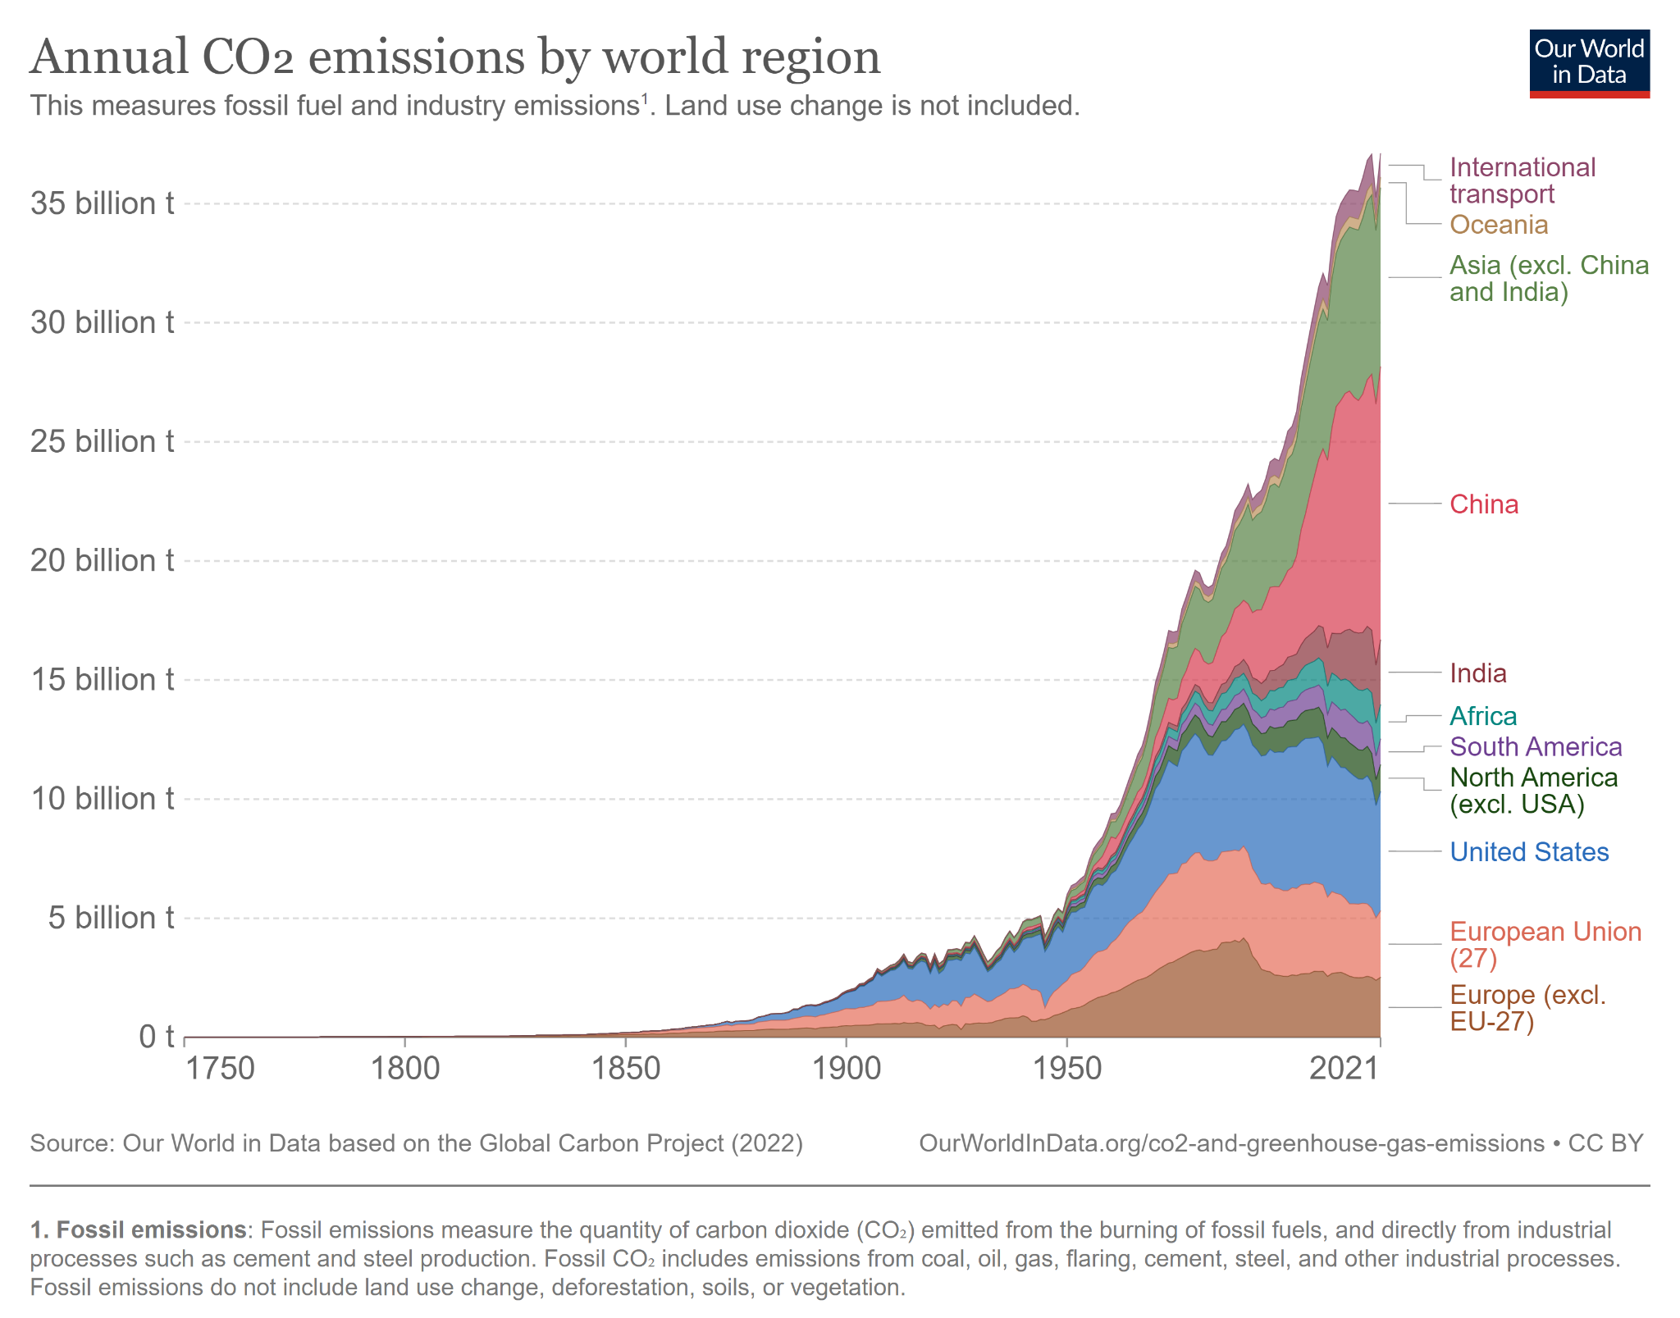
Notes:
Source: https://ourworldindata.org/co2-emissions

Slide 12
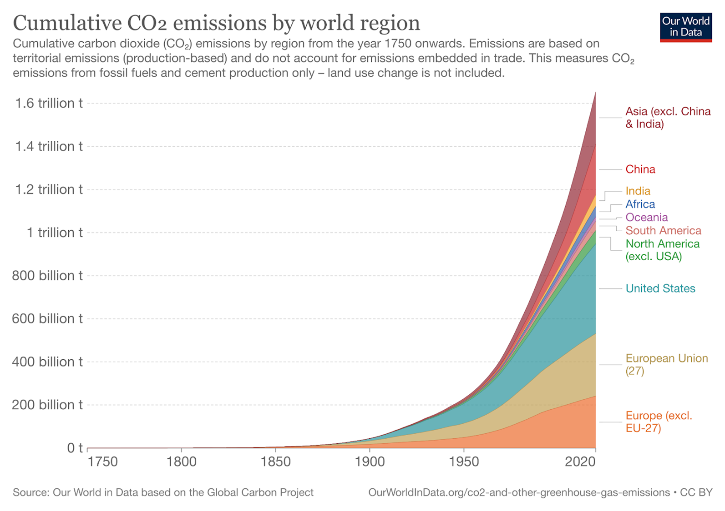
Notes:
Source: https://ourworldindata.org/contributed-most-global-co2

Slide 13
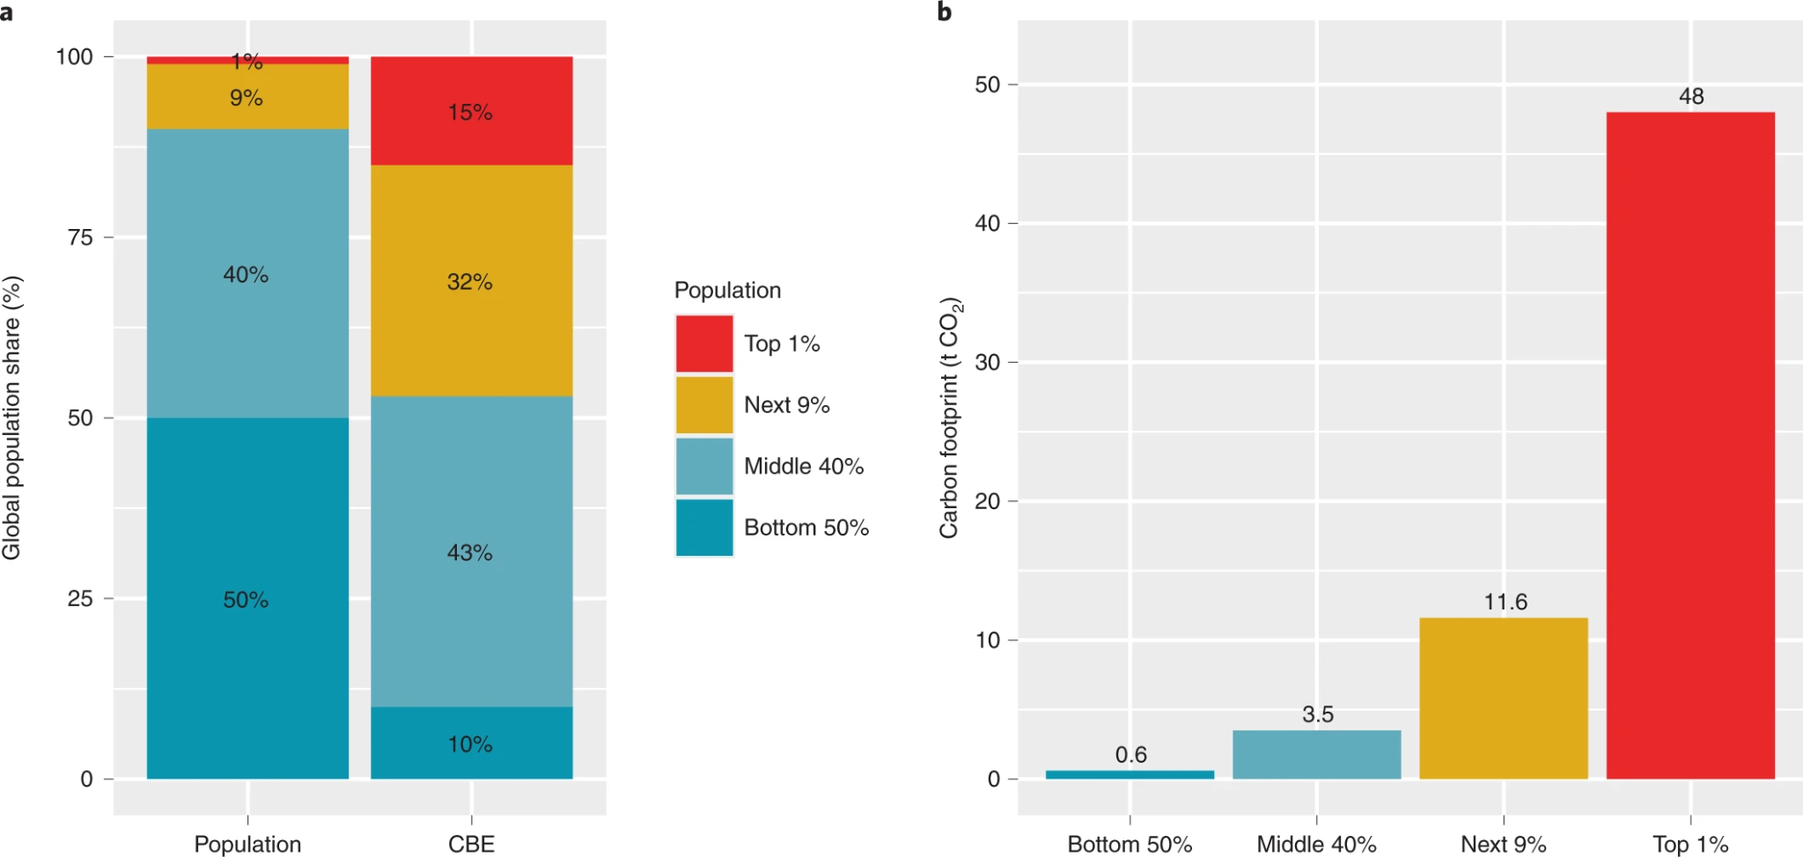
Notes:
a, Global population shares (left) and corresponding shares of current total global carbon emissions (CBE, right). b, Average current carbon footprints of the top 1%, top 10%, middle 40% and bottom 50% of the global population (Source: https://www.nature.com/articles/s41893-021-00842-z#Fig3)

Slide 14
Summary: Measuring Emissions
It’s important to understand the different ways emissions can be measured, as different data shows different stories
Current vs. historical emissions
When measuring current emissions, China is a large emitter. But when historical emissions are taken into account the Global North is responsible for almost all emissions
National vs. non-national
Measuring national per capita emissions can obscure the emissions inequality between people of different income-levels within and across nations

Slide 15
Summary: Key takeaways
Key takeaways on emissions inequality
Top 10% of emitters in the world stand for around half of the world’s emissions, while the bottom 50% of the world emits only 10% of emissions
Recent emissions growth is substantially higher among the richer population

Slide 16
Sovereign Debt Inequality

Slide 17
Sovereign Debt
Sovereign debt is the amount of money that a country's government owes.
It is also known as public debt, national debt or government debt, the debt can be owed to creditors within the country (domestic, or internal debt) as well as to international creditors.
Notes:
Copied from this doc: https://debtjustice.org.uk/wp-content/uploads/2022/10/Debt-and-the-Climate-Crisis-Briefing-October-2022-UPDATED.pdf but think gives really useful framing for this section!
Understanding External Public Debt Governments borrow for a variety of reasons, for example to pay for the costs of unexpected events like pandemics, to smooth economic shocks, and to fund investment or current public spending. In some cases there is a lack of adequate accountability or transparency to the public. Many countries have to finance their regular expenditures like health care through borrowing. In the 2010s there was a large increase in lending. Low interest rates in the western world following the 2008 financial crisis led financiers to seek to lend to global south governments who they charge higher interest rates for loans, and thus potentially make high profits. Meanwhile, global south governments, continue to be encouraged to take on more debt to fund their development efforts by key institutions like the World Bank and IMF. Economic shocks such as falls in commodity prices, climate extreme events and the Covid pandemic cut government revenues and so increase the frequency and seriousness of debt crises. Between 2013 and 2021, the number of global south countries the IMF says are unable to pay their debts or are at high risk of doing so has increased from 17 to 39, while the number at low risk has fallen from 21 to just 7. Countries can borrow from three types of lenders: ■ Foreign governments and foreign public institutions (bilateral creditors) ■ The IMF, the World Bank and other multilateral creditors ■ Private actors such as banks and hedge funds. This paper refers to ‘external sovereign debt’, which is debt owed by governments to creditors outside their country. Governments can also take on domestic debt by borrowing from lenders in their own country, usually domestic banks.

Slide 18
History of Sovereign Debt and its Colonial Roots
Inherited the debts that had been incurred by their colonial rulers
Debts accrued by illegitimate or authoritarian regimes
Argentina, Philippines, South Africa
Debt programmes (structural adjustment) around the 80s
Many forced to participate to get aid
Enforced a lot of economic and financial policies → harmed countries in the long-run (Stiglitz, 2001)
Notes:
Many countries inherited not only the challenges of nation-building but also the debts that had been incurred by their colonial rulers

Slide 19
State of Sovereign Debt
Sovereign debt in Lower Income Economies (LIEs) has increased from an average of over 40% of GDP to 49% in 2019
124 out of 154 developing countries and emerging economies are in a critical debt situation
The debt situation is also exacerbated by crisis (financial crisis, pandemics)
Debt is prioritised over crucial public expenditure → thus, also impacting countries’ ability to mitigate and cover loss of environmental damages
Result → The current debt regime makes it hard for Global South countries to invest in well-being and climate solutions
Notes:
Copied from this doc: https://debtjustice.org.uk/wp-content/uploads/2022/10/Debt-and-the-Climate-Crisis-Briefing-October-2022-UPDATED.pdf but think gives really useful framing for this section!

Slide 20
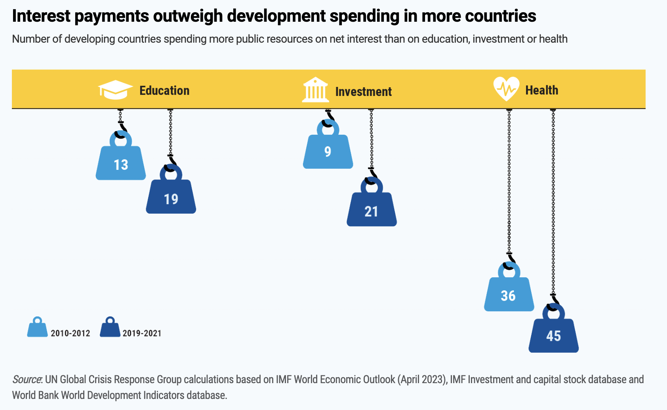
Notes:
https://unctad.org/publication/world-of-debt

Slide 21
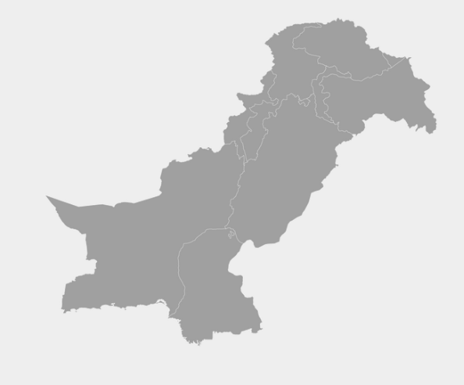
Case Study: Pakistan
Current percentage of annual global emissions: 0.62%
Historically cumulative share of global emissions: 0.3%
Source: https://ourworldindata.org/co2/country/zambia?country=ZMB~PAK~MOZ~BHS~OWID_WRL
Notes:
Please choose case studies as appropriate

Slide 22
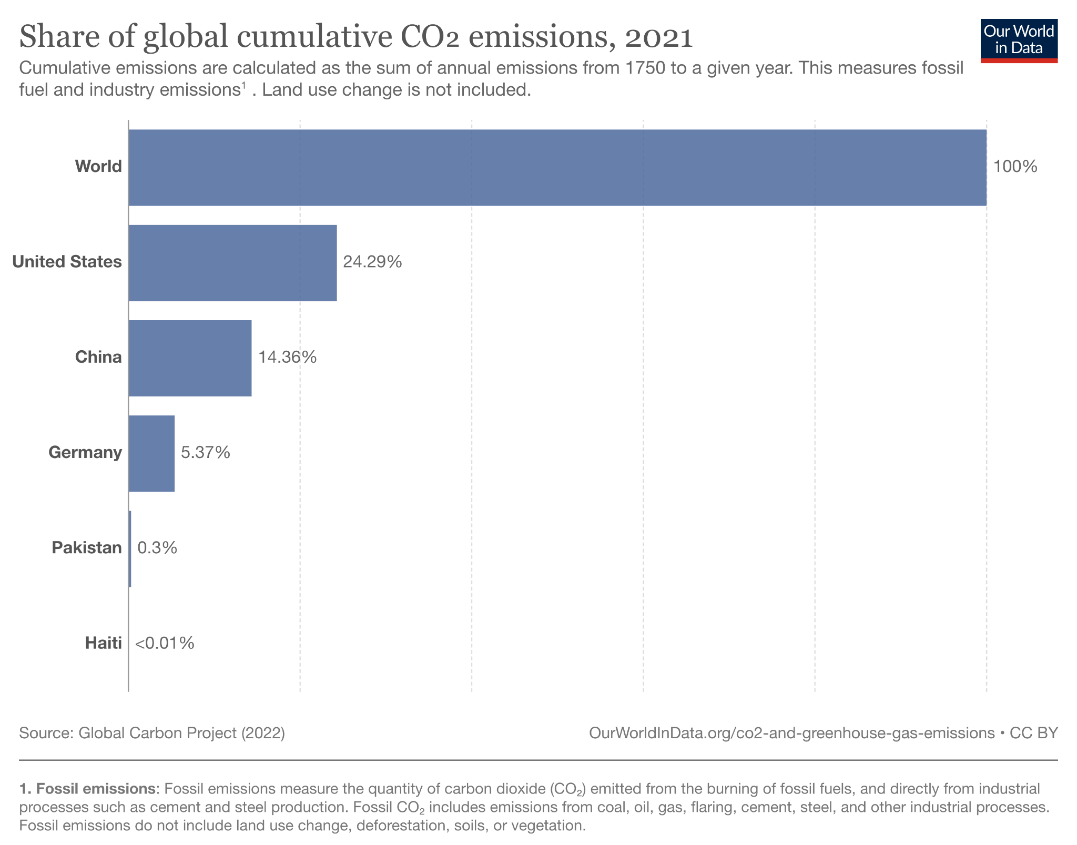
Notes:
Source: ourworldindata.org/co2-and-greenhouse-gas-emissions

Slide 23
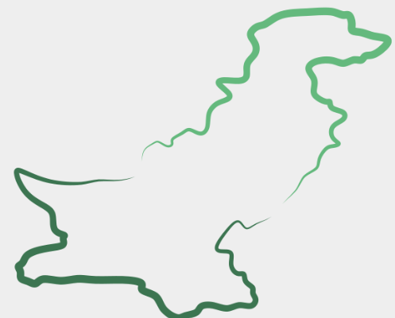
Flooding in Pakistan August 2022
Death toll: 1700
Displaced people: 7.9 million
Damages: 30 billion USD
Pakistan needs funds to provide humanitarian support to its citizens but a large proportion of its GDP, 40% ($18 billion), will go to debt and interest repayment.
Flooded area
Notes:
https://debtjustice.org.uk/wp-content/uploads/2022/10/Debt-and-the-Climate-Crisis-Briefing-October-2022-UPDATED.pdf
https://www.theguardian.com/news/audio/2022/sep/07/the-human-cost-of-pakistans-devastating-floods
https://www.businessinsurance.com/article/20220913/STORY/912352415/Flood-damage-in-Pakistan-may-exceed-$40-billion

Slide 24
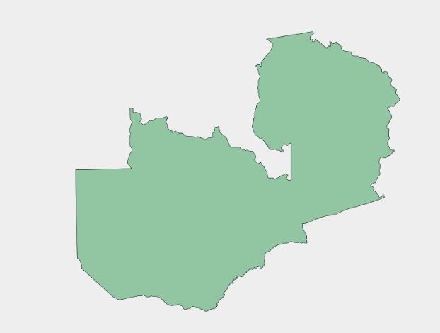
Case Study: Zambia
Current percentage of annual global emissions: 0.02%
Historically cumulative share of global emissions: 0.01%
Source: https://ourworldindata.org/co2/country/zambia?country=ZMB~PAK~MOZ~BHS~OWID_WRL
Notes:
Please choose case studies as appropriate

Slide 25
Zambia and debt default
During the pandemic 2020, Zambia defaulted on its debt payments.
→ Large private creditors, such as Blackrock, refused to meet Zambia’s requests for debt relief.
At the same time, Zambia is experiencing severe climate disasters in flooding, droughts and high temperatures.
In June 2023, Zambia and its official creditors reached an agreement to restructure the countries debt. Interest payments will still be due but over the course of the next decade, Zambia will pay around $750m to creditors rather than the $6 billion that was owed before the debt restructuring.
Notes:
https://debtjustice.org.uk/wp-content/uploads/2022/10/Debt-and-the-Climate-Crisis-Briefing-October-2022-UPDATED.pdf
https://www.reuters.com/world/africa/zambia-bilateral-creditors-agreed-debt-rework-memorandum-understanding-finance-2023-10-14/

Slide 26
Case Study: Mozambique
Current percentage of annual global emissions: 0.02%
Historically cumulative share of global emissions: 0.01%
Source: https://ourworldindata.org/co2/country/zambia?country=ZMB~PAK~MOZ~BHS~OWID_WRL
Notes:
Please choose case studies as appropriate
https://jubileedebt.org.uk/press-release/imf-loan-to-mozambique-following-cyclone-idai-shocking-indictment-of-international-community

Slide 27
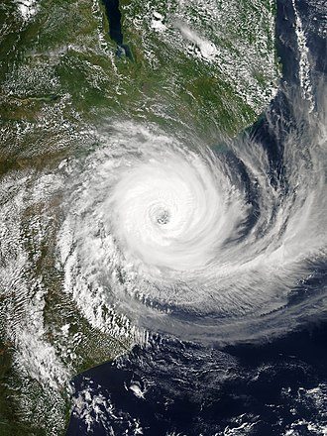
Mozambique and the effects of tropical cyclones
The country was hit by two cyclones between March and April 2019.
Death toll: >602 people
Damages: >$770m
The IMF provided Mozambique with a $118 million loan (rather than granting debt relief) , greatly adding to the debt burden of the country as it attempts to rebuild after the disaster.
Notes:
https://debtjustice.org.uk/wp-content/uploads/2022/10/Debt-and-the-Climate-Crisis-Briefing-October-2022-UPDATED.pdf

Slide 28
Case Study: The Bahamas
Current percentage of annual global emissions: <0.01%
Historically cumulative share of global emissions: <0.01%
Source: https://ourworldindata.org/co2/country/zambia?country=ZMB~PAK~MOZ~BHS~OWID_WRL
Notes:
Please choose case studies as appropriate

Slide 29
The Bahamas and Hurricane Dorian (2019)
Hurricane Dorian cost $3.4 billion in damages and losses
The Bahamas had to rely on increased borrowing to fund the emergency response effort.
Bahamian Finance Minister suggested up to $500 million would need to be borrowed. As a result, the debt level in Bahamas increased from 62% of GDP in 2019 to 72% in 2020.
Notes:
https://debtjustice.org.uk/wp-content/uploads/2022/10/Debt-and-the-Climate-Crisis-Briefing-October-2022-UPDATED.pdf
http://www.tribune242.com/news/2022/jun/02/42bn-hurricane-damages/
http://newdebtcpdc.gboatswain.com/
https://www.bloomberg.com/news/articles/2020-01-17/bahamas-storm-toll-3-4-billion-loss-and-years-of-rebuilding?leadSource=uverify%20wall

Slide 30
The Mechanisms of Reparations

Slide 31
What could climate reparations look like in practice? Loss and Damages Fund COP28
Delegates at the COP28 talks in UAE in November 2023 agreed to establish a Loss and Damage Fund for countries affected by climate change.
Fund involves G20 countries (represent around 75 % of current global greenhouse emissions) providing financial support to countries affected by the global warming.
Initial funding is $429m (from EU, UK, USA, Japan, UAE)
Studies estimate that costs of loss and damages in developing countries to rise to $400bn annually
Notes:
https://www.theguardian.com/environment/2023/nov/30/agreement-on-loss-and-damage-deal-expected-on-first-day-of-cop28-talks
https://assets-global.website-files.com/605869242b205050a0579e87/655b50e163c953059360564d_L%26DC_L%26D_Package_for_COP28_20112023_1227.pdf

Slide 32
Assigning climate responsibility: How to measure emissions
Production-based emissions: CO₂ equivalent emissions generated during production within national boundaries. Used by United Nations Framework Convention on Climate Change and COP
Consumption-based: emissions resulting from a country’s economic activity to produce goods and services
Loss-based: calculating reparations in terms of GDP gains and losses as a result to over- or under-emitting
Damage-based: calculating reparations on the basis of the financial damage as a result of climate-based disaster
How do we take into account historical emissions as well as current emissions?
Notes:
Quantifying and Identifying the paying and receiving countries
https://www.iioa.org/conferences/20th/papers/files/775_20120514041_Marques_income.pdf
https://www.clubofrome.org/wp-content/uploads/2022/07/Earth4All_Deep_Dive_Ghosh.pdf
Historical vs. current emissions There are debates about what year to use as a baseline for calculating responsibility for historical emissions, with studies often providing a range of different start dates:
1960 is a common mid-range baseline given that scientific understanding of the influence on atmospheric CO2 and temperature from burning fossil fuels was well understood
1850, a common early baseline from start of Industrial Revolution in the United Kingdom
1992, the year that the United Nations Framework Convention on Climate Change was established
While climate science was not as developed, disregard of emissions before the 1990s neglects the importance of historical emissions. (Hickel, Fanning, 2022)

Slide 33
Assigning climate responsibility: atmosphere shared commons
Atmosphere as a shared commons.
Jason Hickel quantifies national responsibility for damages related to climate change by looking at national contributions to cumulative CO₂ emissions in excess of the planetary boundary of 350 ppm atmospheric CO₂ concentration (Hickel, 2020).
Analyses the ‘fair share’ of a safe global carbon budget for each country on the principle of equal per capita access to atmospheric commons (Hickel, 2020).
Notes:
https://www.thelancet.com/action/showPdf?pii=S2542-5196%2820%2930196-0
Atmosphere as a shared commons Not all countries are equally responsible for the depletion of carbon budgets, however; some nations have contributed more to causing this crisis than others. This disproportionate historical responsibility is problematic from a climate justice perspective that recognizes the atmosphere as a shared commons, to which all people are entitled to a fair and equitable use Scholars have drawn on this principle to argue that carbon budgets should be shared equitably and that cumulative emissions in excess of fair shares represent a form of appropriation of atmospheric commons, which has been framed in the language of ‘climate debt’ and ‘climate coloniality’. Acknowledging issues of equity is essential to establishing trust and buy-in to the negotiation process. (Hickel, Fanning, 2022)

Slide 34
Assigning climate responsibility: atmosphere shared commons
Total Global Carbon Budget (Gigatonnes of CO₂)
Hickel (2020)
Notes:
https://www.thelancet.com/action/showPdf?pii=S2542-5196%2820%2930196-0
How does Hickel calculate a country’s national ‘fair share’ of carbon usage? To do this, we first need to introduce something called a ‘carbon budget’. In order to limit the world’s atmospheric CO2 concentration and abide by the international commitment to limit global warming to as close to 1.5C as possible, fossil fuel use (and by extension carbon emissions must fall dramatically. But how much carbon emitted while maintaining this commitment? This limit on temperature increases can be translated into a ‘carbon budget’, or the amount of carbon dioxide (CO2) that can be emitted through the burning of fossil fuels by 2100 (and beyond) before the average global temperature rise exceeds 2°C. This translated to around 830 gigatonnes of carbon dioxide (GtCO2) to be used from 2017. (https://www.chathamhouse.org/2018/07/carbon-risk-and-resilience/2-decarbonization-and-global-fossil-fuel-markets)
Hickel multiplies this carbon budget figure (830 GtCO2) by a country’s proportion of the global population (dividing a country’s approximate population by the approximate global population).
NB These fair shares are not static; they change over time as populations change. This analysis is not, in other words, a metric for individual fair shares at any given time in history (ie, how much a person can emit in any year), but rather for national fair shares over a historical period. The unit of responsibility here is the nation-state across time.

Slide 35
Assigning climate responsibility: atmosphere shared commons
Historical and consumption based emissions of a given country
Hickel (2020)
Global sum of individual national overshoots
Notes:
https://www.thelancet.com/action/showPdf?pii=S2542-5196%2820%2930196-0
Hickel continues the analysis, by using the national fair shares of a safe global carbon budget that we just derived. These fair shares were then subtracted from countries’ actual historical emissions (territorial emissions from 1850 to 1969, and consumption-based emissions from 1970 to 2015) to determine the extent to which each country has overshot or undershot its fair share. Through this approach, each country’s share of responsibility for global emissions in excess of the planetary boundary was calculated.
Responsibility here was measured in terms of each country’s overshoot as a proportion of total national overshoots. Notably, some countries have cumulative emissions that fall entirely within their boundary fair share. Such countries would be said to be in a state of undershoot, and bear no responsibility for climate breakdown; instead, they hold a climate credit with respect to overshooting countries, and overshooting countries in turn owe them a climate debt. (Hickel 2020)

Slide 36
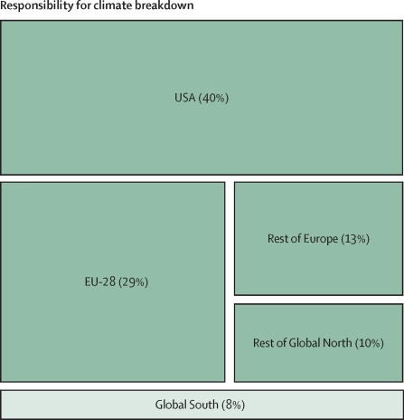
Assigning climate responsibility: atmosphere shared commons
National contributions to cumulative CO₂ emissions in excess of the planetary boundary of 350 ppm atmospheric CO₂ concentration (Hickel, 2020).
This method suggests high-income countries have a degree of responsibility for climate damages.
Most countries in the Global South were within their boundary fair shares, including China and India (but China will overshoot soon).
Notes:
https://www.thelancet.com/action/showPdf?pii=S2542-5196%2820%2930196-0
As of 2015, the USA was responsible for 40% of excess global CO2 emissions. The European Union (EU-28) was responsible for 29%. The G8 nations (the USA, EU-28, Russia, Japan, and Canada) were together responsible for 85%. Countries classified by the UN Framework Convention on Climate Change as Annex I nations (ie, most industrialised countries) were responsible for 90% of excess emissions. The Global North was responsible for 92%. By contrast, most countries in the Global South were within their boundary fair shares, including India and China (although China will overshoot soon).
These figures indicate that high-income countries have a greater degree of responsibility for climate damages than previous methods have implied. These results offer a just framework for attributing national responsibility for excess emissions, and a guide for determining national liability for damages related to climate change, consistent with the principles of planetary boundaries and equal access to atmospheric commons. (Hickel 2020)

Slide 37
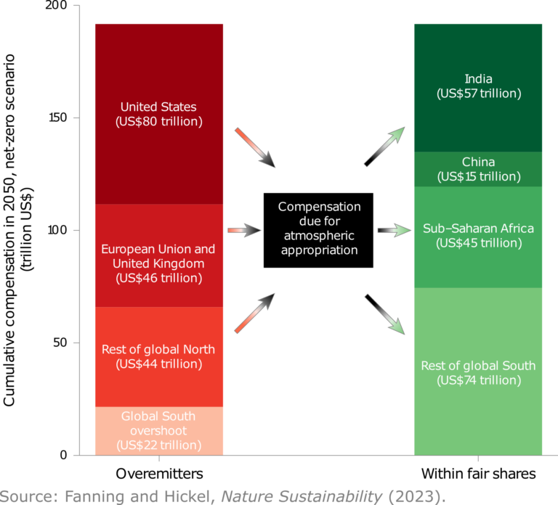
Moving from assigning climate responsibility to facilitating climate reparations
Calculating climate responsibility can then be translated into financial reparations (Hickel, 2023).
Funding would be repatriated from overmitters to those producing carbon emissions within their fair share.
This would provide funding during climate disaster.
Notes:
https://www.nature.com/articles/s41893-023-01130-8
Nevertheless, our results show undershooting countries would be entitled to substantial compensation—more than US$100 trillion—even with a 1992 baseline.

Slide 38
Facilitating climate reparations in practice: how to fund it?
There have been a number of proposals as to how to facilitate these reparations including:
Higher taxes on fossil fuel industries
The implementation of an international tax
Cancellation of high levels of sovereign debt (next slide)
Notes:
Loss and Damages: A review of the literature and directions for future research https://wires.onlinelibrary.wiley.com/doi/epdf/10.1002/wcc.564

Slide 39
Facilitating climate reparations in practice: debt cancellation
Climate policy-makers and negotiators have suggested a range of policy approaches to alleviate the debt burden during climate crises
Provide debt cancellation for low-income countries with a exposure to climate disasters so they are able to have access to the funds to respond
Cancel debt interest payments in the event of climate disaster to funds to go to emergency response
Notes:
https://debtjustice.org.uk/wp-content/uploads/2022/10/Debt-and-the-Climate-Crisis-Briefing-October-2022-UPDATED.pdf

Slide 40
Facilitating climate reparations in practice: debt cancellation
In 1953 in the aftermath of World War II, the Western Allied powers passed the London Debt Agreement, a radical plan which wrote off half of Germany’s external debt and converted the rest into low-interest loans. Germany only had to repay its debt if the economy ran a trade surplus.
The German economy boomed and was re-integrated into the global market
Notes:
https://academic.oup.com/ereh/article/23/1/1/4995332
https://www.project-syndicate.org/commentary/coronavirus-debt-crisis-by-jayati-ghosh-2020-03

Slide 41
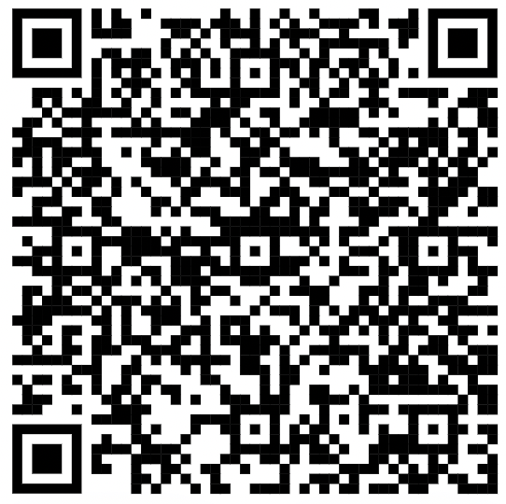
Activity: compare/analyse your own country (or a country of choice)
Choose a country to explore their historical CO₂ emissions up to 2019 and other scenarios up to 2050
Using the line charts:
When did/will the country pass the fair share (1.5°C?) – and what does this tell you?
How does your country compare to other countries nearby and around the world?
Could climate reparations be used to address global inequalities that your country is part of? What could the benefits be? What could the problems be?
https://goodlife.leeds.ac.uk/related-research/atmospheric-appropriation/

Slide 42
What have we learnt today?
Quantifying and Identifying the paying and receiving countries of climate reparations
Big moral questions:
Where does the economic burden of climate change related disasters lie?
Notes:
Quantifying and Identifying the paying and receiving countries
Big moral questions:
Where does the economic burden of climate change related disasters lie?
https://www.clubofrome.org/wp-content/uploads/2022/07/Earth4All_Deep_Dive_Ghosh.pdf

Slide 43
APPENDIX

Slide 44
Vocabulary
Climate Reparations
Sovereign Debt
Atmospheric CO2 concentration
Global Carbon budget
Fair share
Sovereign debt

Slide 45
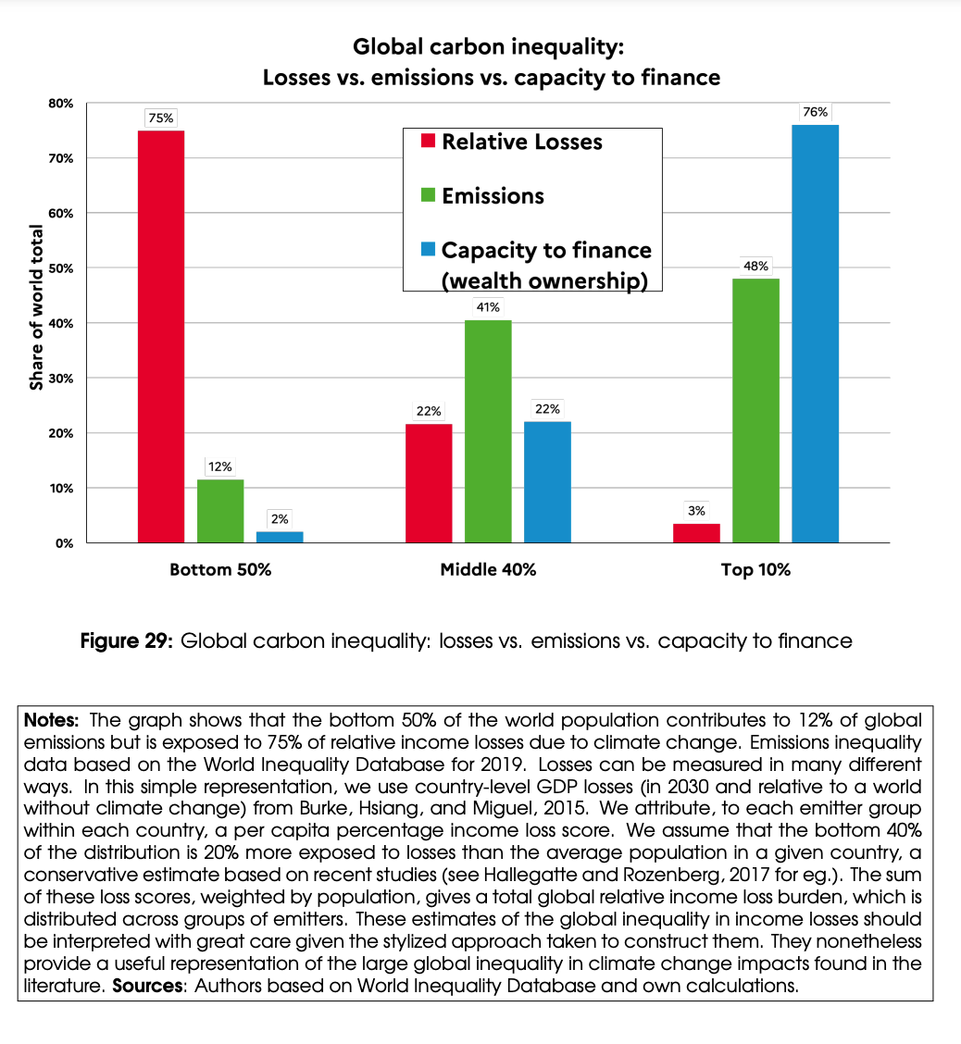
Notes:
I think that this works better in the section above - maybe just before the case studies?

Slide 46
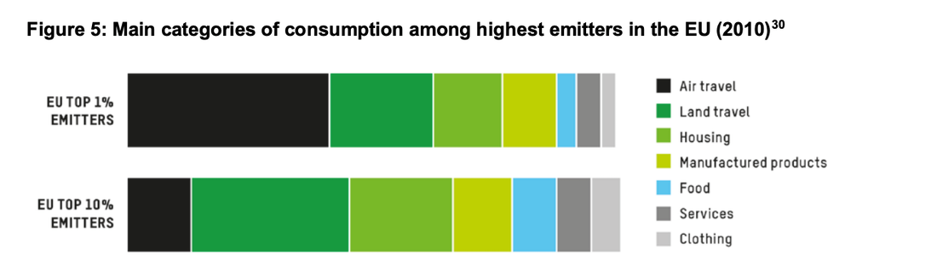
Notes:
Source: Oxfam (https://oxfamilibrary.openrepository.com/bitstream/handle/10546/621052/mb-confronting-carbon-inequality-210920-en.pdf)

Slide 47
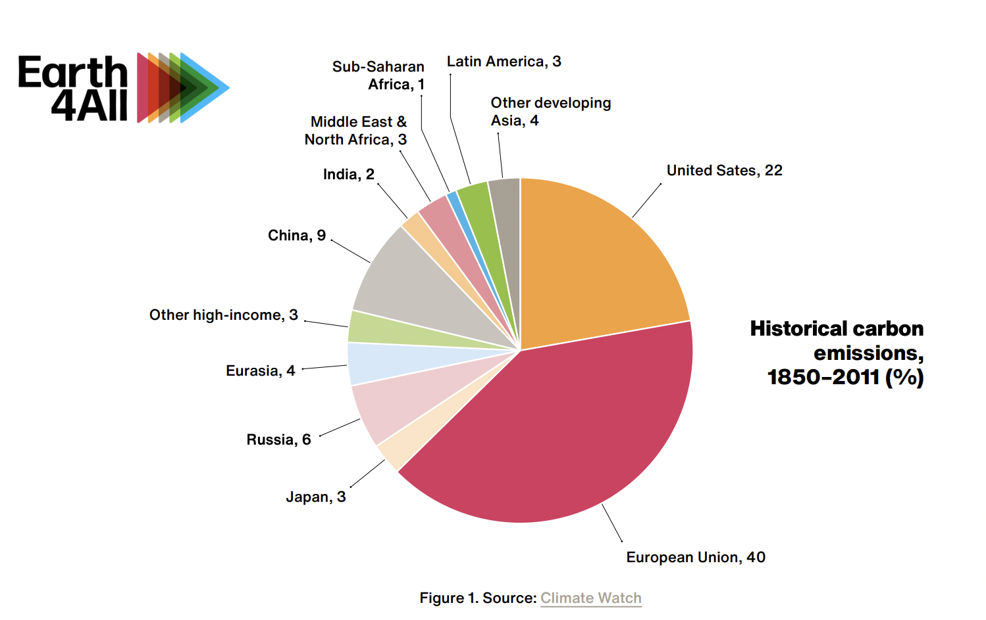
Notes:
Source: https://www.clubofrome.org/wp-content/uploads/2022/07/Earth4All_Deep_Dive_Ghosh.pdf
‘Today’s rich countries are responsible for nearly 80% of all human-related carbon emissions from 1850–2011, as Figure 1 indicates. This historical accumulation of greenhouse gas emissions is the major contributor to the climate impacts the world is facing today. Fundamentally, these problems are a result of that over-exploitation and abuse of the planet by a small group of now-rich countries, which together account for only around 14% of today’s global population. Although some of these emissions occurred before the science of climate change was clear, it is worth noting that more than 50% of these historical emissions occurred in the last 30 years. Over the past three decades, the science of climate change has become increasingly evident and widely accepted, and the technologies for climate mitigation have developed significantly. Clearly, rich countries could have done more to avert the climate crisis we now face.’

Slide 48
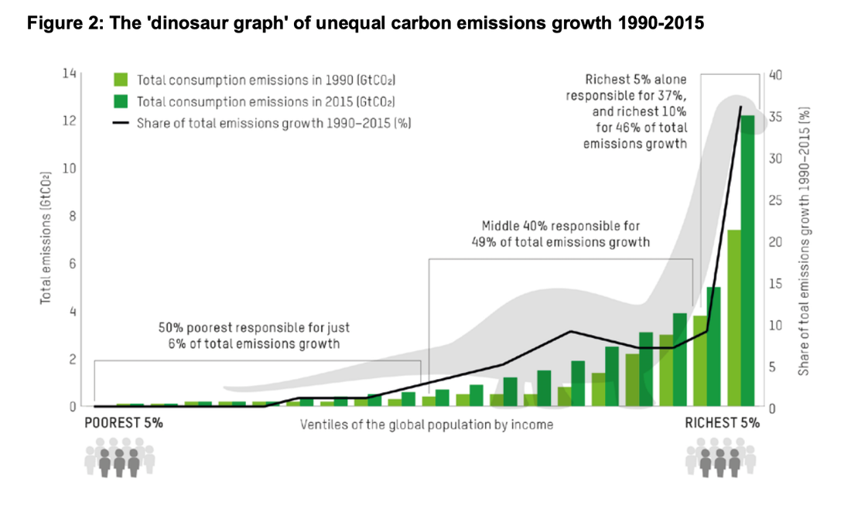
Notes:
https://wir2022.wid.world/chapter-6/
https://oxfamilibrary.openrepository.com/bitstream/handle/10546/621052/mb-confronting-carbon-inequality-210920-en.pdf

Slide 49
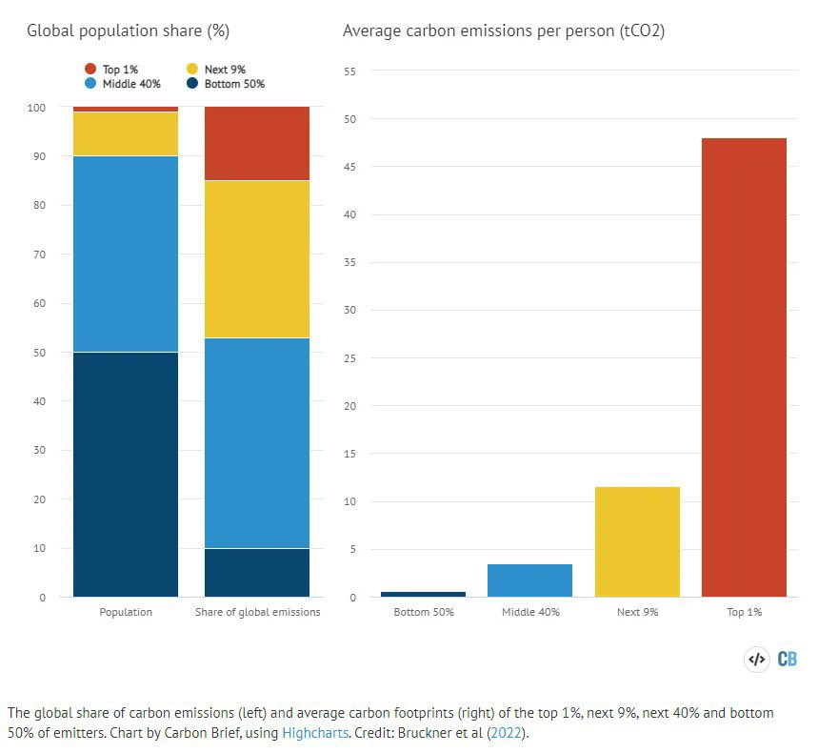

Slide 50
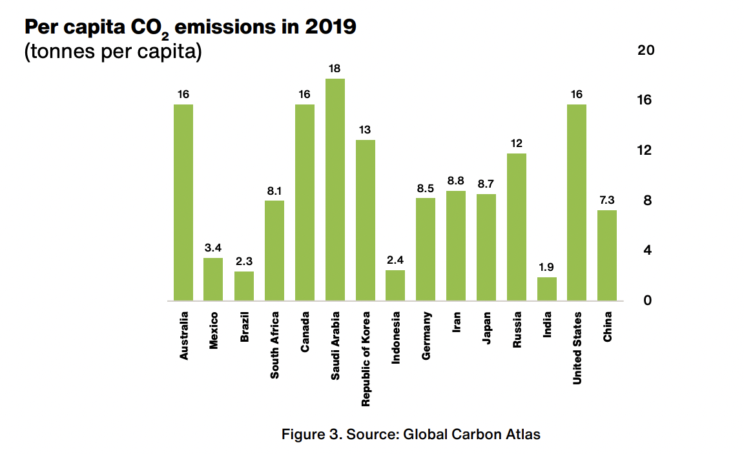
Notes:
https://www.clubofrome.org/wp-content/uploads/2022/07/Earth4All_Deep_Dive_Ghosh.pdf

Slide 51
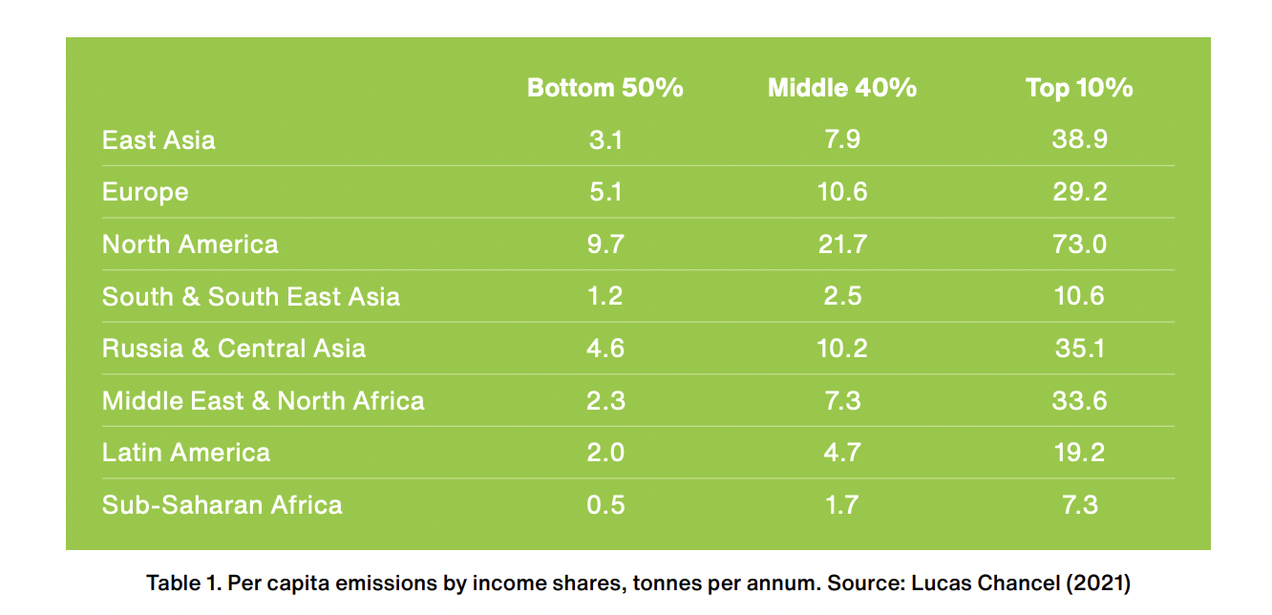
Notes:
https://www.clubofrome.org/wp-content/uploads/2022/07/Earth4All_Deep_Dive_Ghosh.pdf

